Slide 1

ConsumerHort.org
Help Grow the Industry

Slide 2


What Is NICH?
How Did NICH Begin?
Who Is NICH?
What Will We Do?
Why Increase Value of Horticulture?
How Can You Help?

Slide 3

How Did It Begin?
1

Slide 4

History of NICH
It all started with 10 academicians at a grant writing workshop in Atlanta in 2012
Notes:
The assignment: Come up with a viable proposal and a source of funding. Not only could they not get on the same page, they couldn’t find one single federal agency to fund consumer horticulture. Realizing their common plight, these 10 scholars step up a national committee.

Slide 5
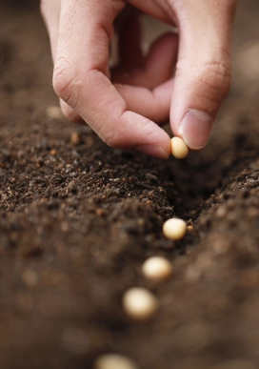
History of NICH
“Get organized. Write a national strategic plan for consumer horticulture.”
Tom Bewick
USDA

Slide 6
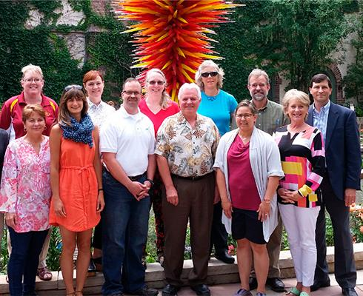
History of NICH
2015
1st Draft of Vision, Mission & Goals
2016
Objectives & Elections
2017
Committees
Notes:
Tom Bewick pulled together a committee of 12 people from across the country who drafted a rough strategic plan. Next a group of about 50 meet in Washington, DC in 2015 to write the mission, vision and goals. Next a group met in Denver and elected officers and wrote objectives. Committees were formed and by-laws written. And here we are today to craft the plan.

Slide 7
Who is NICH?
2

Slide 8

Colleges
Universities
Researchers
Government
Extension
Master Gardeners
Breeders
Growers
Landscapers
Service Pros
Retailers
Vendors
Public
Gardens
Non-Profits
Associations
Affliates

Slide 9

Vision of NICH
NICH’s vision is
to increase participation
in gardening,
both indoors and out,
from 70% to 90%
by 2025

Slide 10

NICH Mission
Grow a healthy world
through plants,
gardens,
and
landscapes

Slide 11
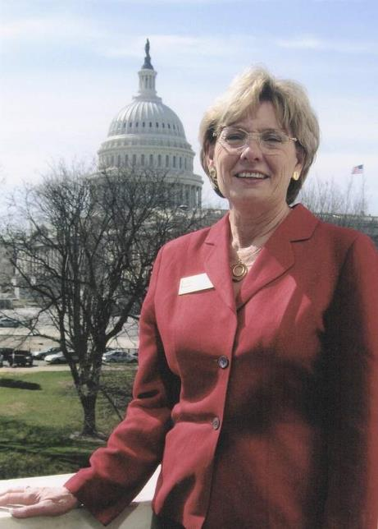
NICH Is Working to . . .
Create a unified voice

Slide 12
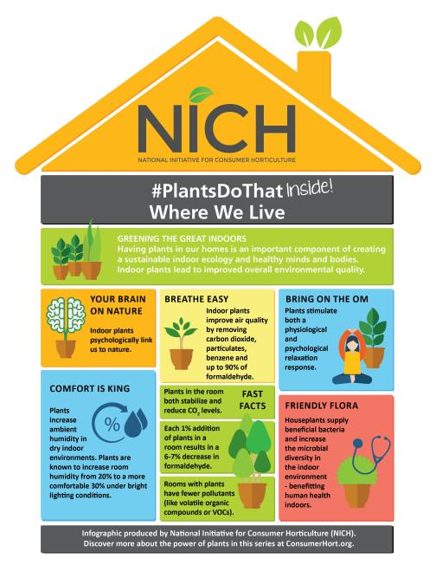
NICH Is Working to . . .
Promote the benefits of plants, garden and landscapes

Slide 13
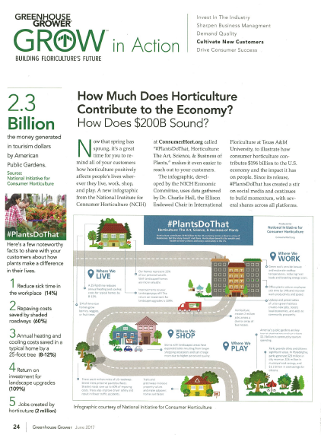
NICH Is Working to . . .
Increase the value of our $196 billion industry that creates
2 million jobs

Slide 14
What Will We Do?
3
Notes:
We are now going to go over the mix of activities we feel you need to attract more visitors to the site and move toward the end goal.

Slide 15
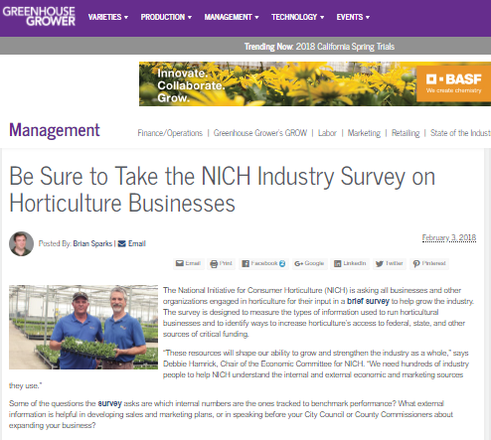
NICH will . . .
1.Listen to the industry
Notes:
Listen to the industry to prioritize strategies and develop tactics to increase demand for consumer horticulture on a local, state and national level

Slide 16
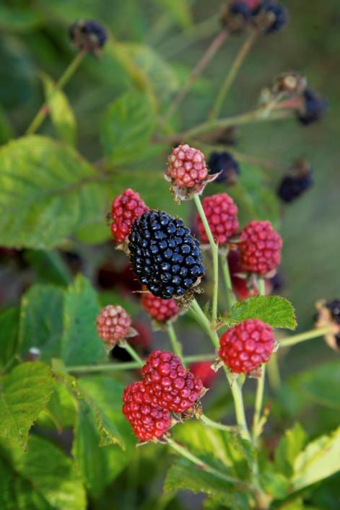
NICH will . . .
2. Define research priorities

Slide 17

NICH will . . .
3. Create
a plan
Notes:
Create a business plan to develop strategies, tactics and priorities to stimulate consumer horticulture in the U.S.

Slide 18
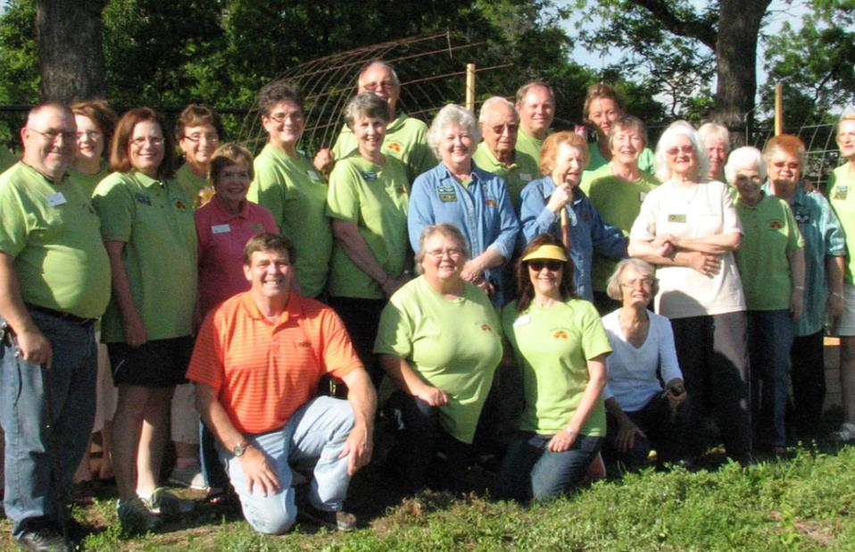
NICH will . . .
4. Build our strength in numbers
Notes:
Build our strength in numbers to demonstrate we have nation-wide industry support

Slide 19

NICH will . . .
5. Seek federal and state funding
Notes:
Seek federal support for consumer horticulture from federal and state funding, including the Specialty Crop Research Initiative supported by the USDA Farm Bill

Slide 20
Why Increase Value of Horticulture?
4

Slide 21
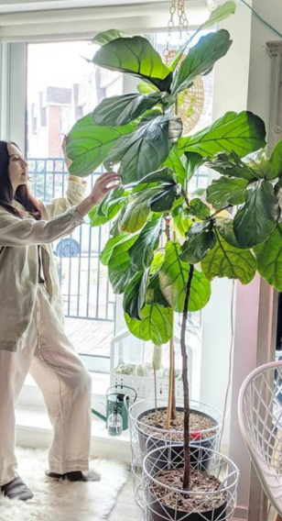
Increase Value of Horticulture
More consumers create more demand, more sales, more engagement, more funding, more relevancy and longevity
Notes:
Seek federal support for consumer horticulture from federal and state funding, including the Specialty Crop Research Initiative supported by the USDA Farm Bill

Slide 22

Increase Value of Horticulture
Greater collaboration leads to more efficiency, power and impact with decision makers
Notes:
Seek federal support for consumer horticulture from federal and state funding, including the Specialty Crop Research Initiative supported by the USDA Farm Bill

Slide 23

Increase Value of Horticulture
Comprehensive research shows the social, health, economic and environmental benefits of consumer horticulture
Notes:
Seek federal support for consumer horticulture from federal and state funding, including the Specialty Crop Research Initiative supported by the USDA Farm Bill

Slide 24
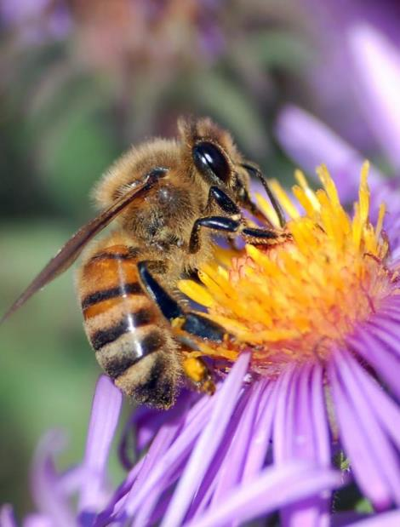
Increase Value of Horticulture
Increased awareness promotes the vital role plants play in a healthy lifestyle, healthy community and healthy world
Notes:
Seek federal support for consumer horticulture from federal and state funding, including the Specialty Crop Research Initiative supported by the USDA Farm Bill

Slide 25

Increase Value of Horticulture
Bottom Line:
More Value Means
More Business
More Jobs
More Grants
More Life
More People Gardening

Slide 26
What Can You Do to Help
Grow the Industry?
3
Notes:
We are now going to go over the mix of activities we feel you need to attract more visitors to the site and move toward the end goal.

Slide 27
How Can I Help?
Join our unified effort to make this happen & add to our strength in numbers
Offer your expert advice, feedback and input
Spread the message and tell 10 friends
Get Involved with a committee & have a bigger impact
Recommend someone who should be involved
Sign up @ ConsumerHort.org

Slide 28
Join a NICH Committee or Council
NICH Executive Committee
Chair: Casey Sclar, Ph.D., Executive Director, American Public Gardens Association
Co-Chairs: Dr. Ellen Bauske, University of Georgia Center for Urban Agriculture; and Tom Underwood, Executive Director, Birmingham Botanic Gardens
Secretary / Treasurer: Dr. Gail Langellotto, Associate Professor, Oregon State University Urban and Community Horticulture Extension, Statewide Master Gardener Coordinator
MarCom: Susan McCoy, President, Garden Media Group
Government Liaison
USDA Liaison: Tom Bewick, National Program Leader, USDA
NICH Committees & Councils
Community Committee: Pam Bennett, Associate Professor, State Master Gardener Volunteer Program Director, Ohio State University
Economic Committee : Debbie Hamrick, Director of Specialty Crops, North Carolina Farm Bureau Federation
Environmental Committee Council: Julie Weisenhorn, Associate Extension Professor, Depart of Horticultural Sciences, University of Minnesota
Academic/Government Council: Margaret Pooler, Research Leader, USDA/ARS U.S. National Arboretum
Commercial Council: Clint Albin, President, Clint Albin Consulting
Non-Profits Council: Shannon Spurlock, Director of Public Affairs and Policy, Denver Urban Gardens

Slide 29
Give us your feedback
& join the army growing
our horticulture industry.
ConsumerHort.org
Connect with NICH today
Notes:
We are now going to go over the mix of activities we feel you need to attract more visitors to the site and move toward the end goal.

