Slide 1

Research & Extension Objectives & Priorities
Ellen Bauske, Ph.D., NICH Co-Chair
Gail Langellotto, Ph.D., NICH Secretary

Slide 2
Research & Extension, Objectives & Priorities
The importance of research & extension priorities
State, federal funding to support CH research & extension
NICH Goals & Objectives, Overview
Research & Extension Objectives & Priorities
Notes:
ELLEN
We’re here to talk the Extension and Research Objectives and Priorities that will guide NICH’s work for the next 2 years. In 30 action-packed minutes, we will provide (1) reasons for the importance of having research and extension priorities specific to consumer horticulture; (2) a brief introduction to how calls for state and federal funding work, and how consumer horticulture has fared, to advance research and extension in consumer horticulture; (3) a very brief history of how we have arrived at goals and objectives to guide work in consumer horticulture; and then we’ll finish up by (4) presenting NICH’s research and extension objectives and priorities

Slide 3
Research & Extension, Objectives & Priorities
Importance
Funding
NICH
Objectives
Notes:
ELLEN
And to help folks follow along, we have abbreviated these four parts of our presentation, using the sidebars, on the left.

Slide 4
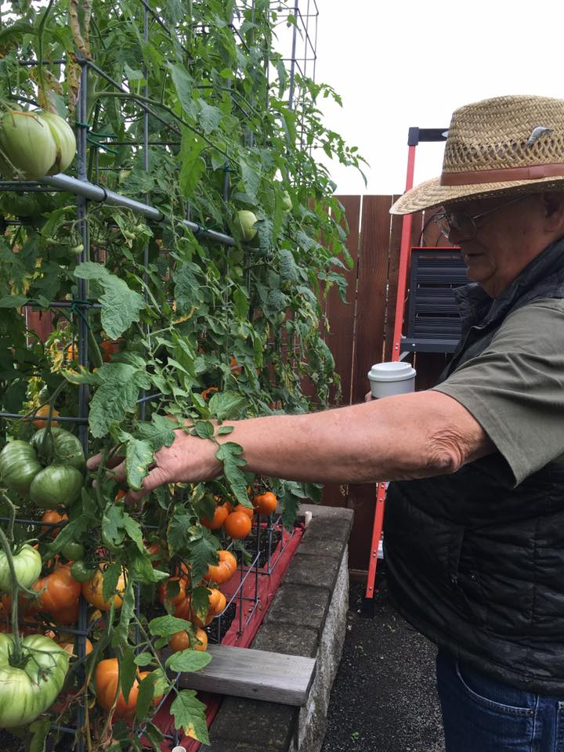
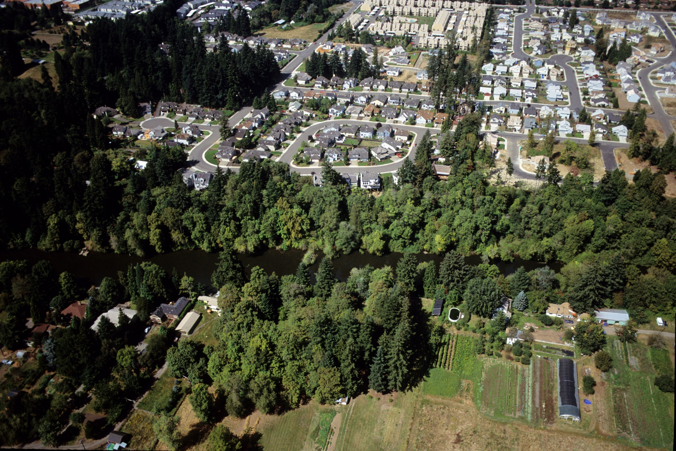
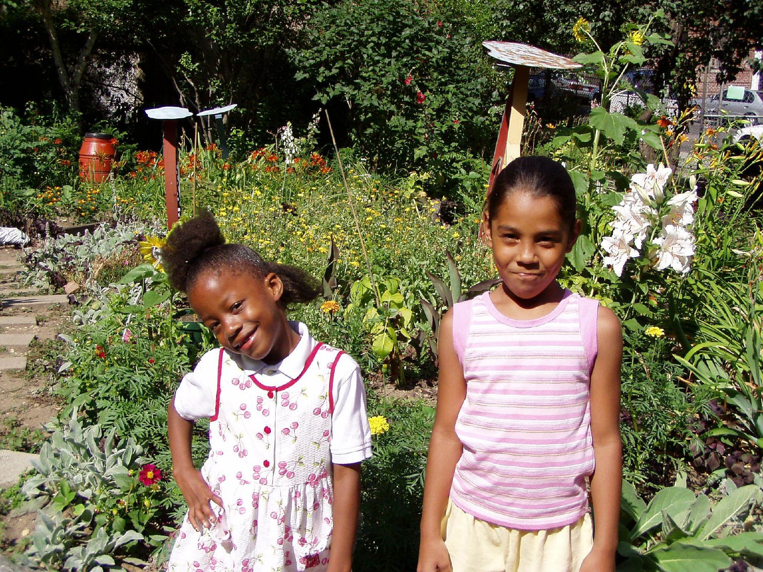
Research & Extension, Objectives & Priorities
Importance
Consumer horticulture has a large footprint. Gardeners and landscapers manage:
2% of US land area
25-30% of US urban land area
>50% of urban greenspace in US
Funding
NICH
Objectives
Notes:
GAIL:
Prioritizing Extension AND Research related to consumer horticulture is important for many reasons. First, consumer horticulture has a large footprint, particularly in urban areas. Gardeners and landscapers directly manage 2% of all US land area, 25-30% of all urban land area, and more than 50% of all urban greenspace in the United States.

Slide 5
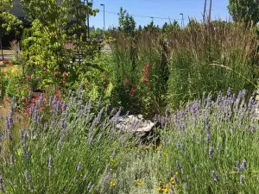
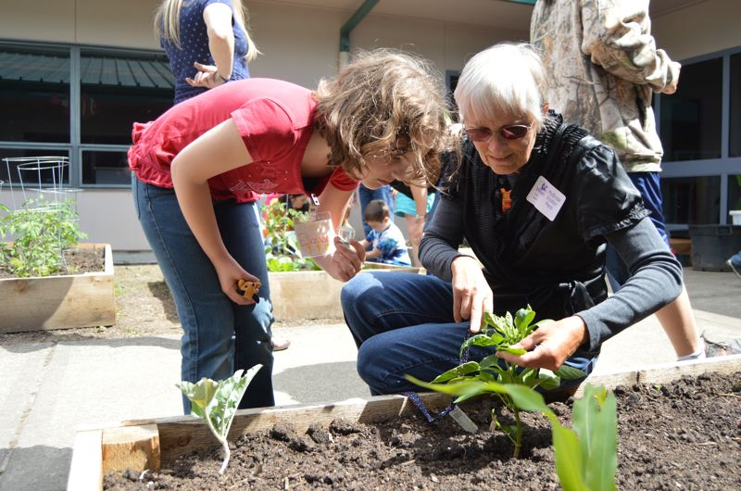
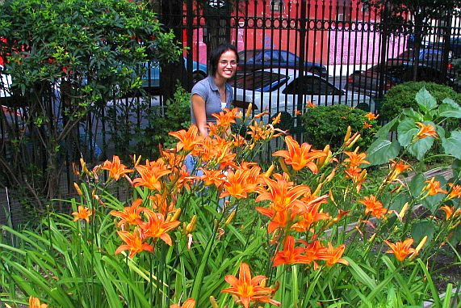
Research & Extension, Objectives & Priorities
Importance
Consumer Horticulture is the agriculture the majority of US people know
80% of all US households garden (Nat’l Garden Association)
80% of all US people live in urban areas, near gardens, parks, landscapes
Funding
NICH
Objectives
Notes:
GAIL:
In addition to a large urban footprint, consumer horticulture is the agriculture that the majority of people in the United States see, experience, and know.
About 80% of all US households participate in some form of gardening, whether it be in a home garden, community garden, church garden, or patio garden.
And, currently, more people about 80% of all Americans, live in urban areas than in rural areas. And this trend towards urban living is expected to continue. So, even if folks don’t actively garden, they are immersed in consumer horticulture in urban areas, when they visit a botanical garden, a public park, or a landscaped housing community or retail center.

Slide 6
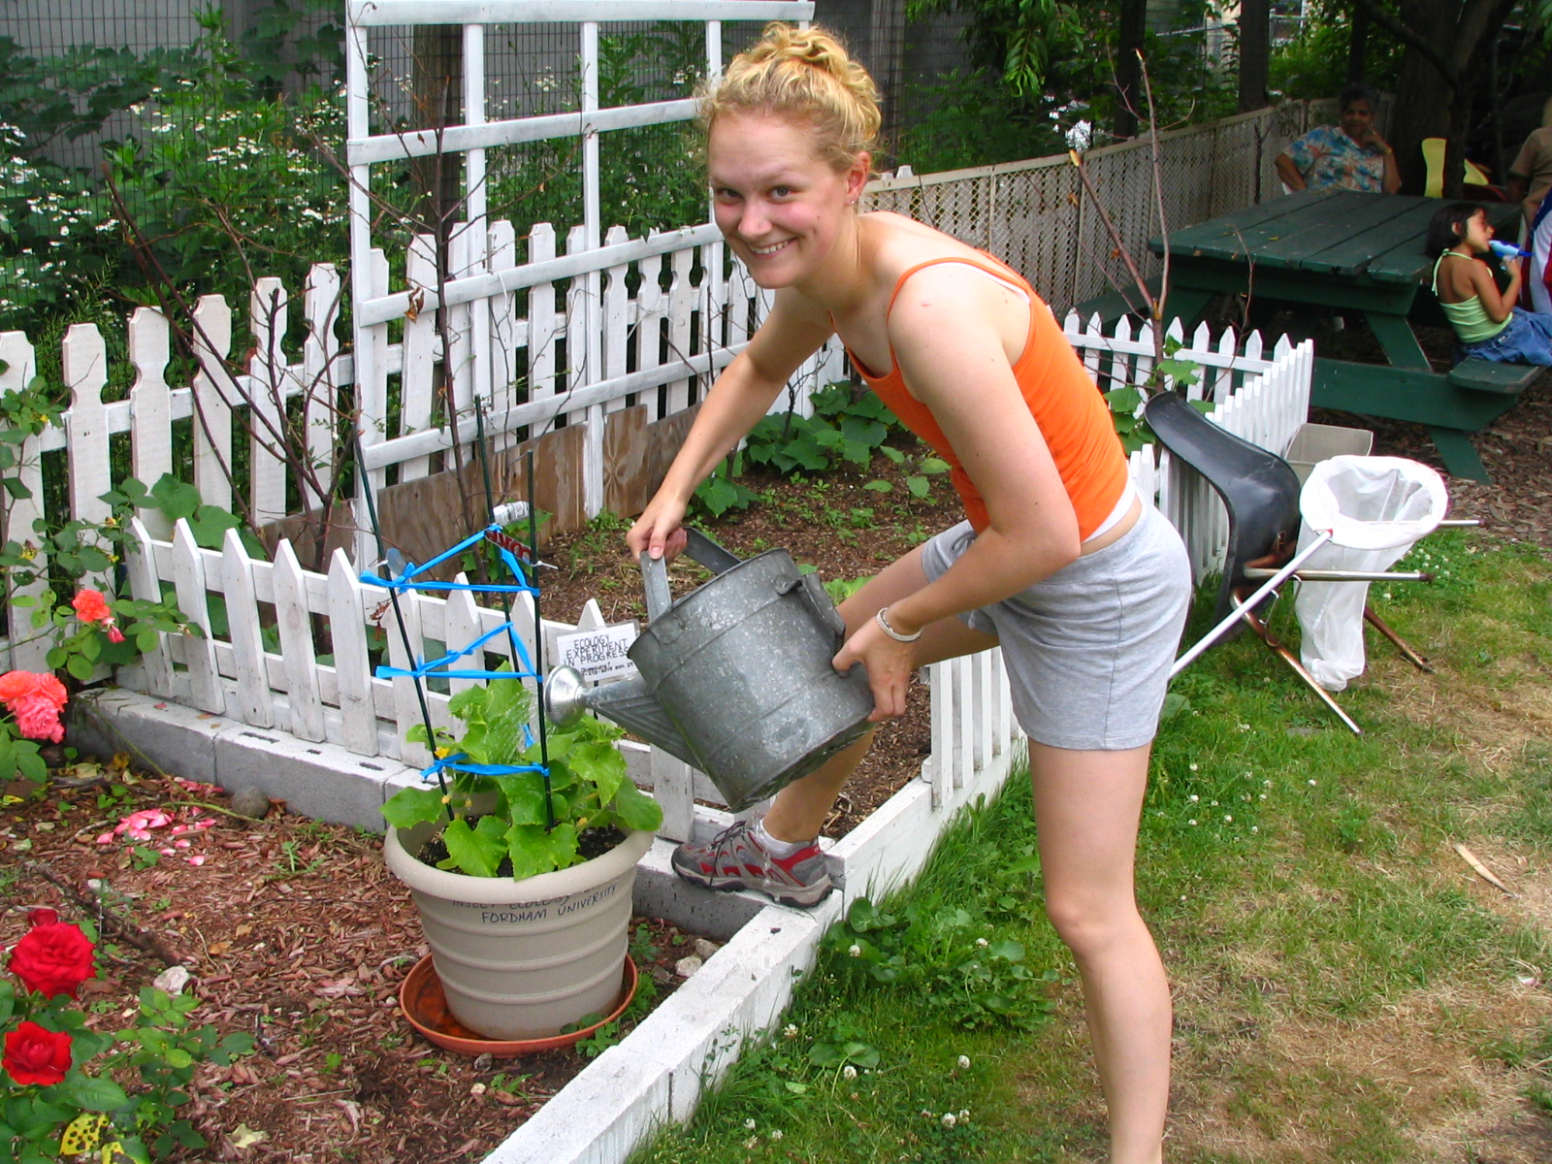

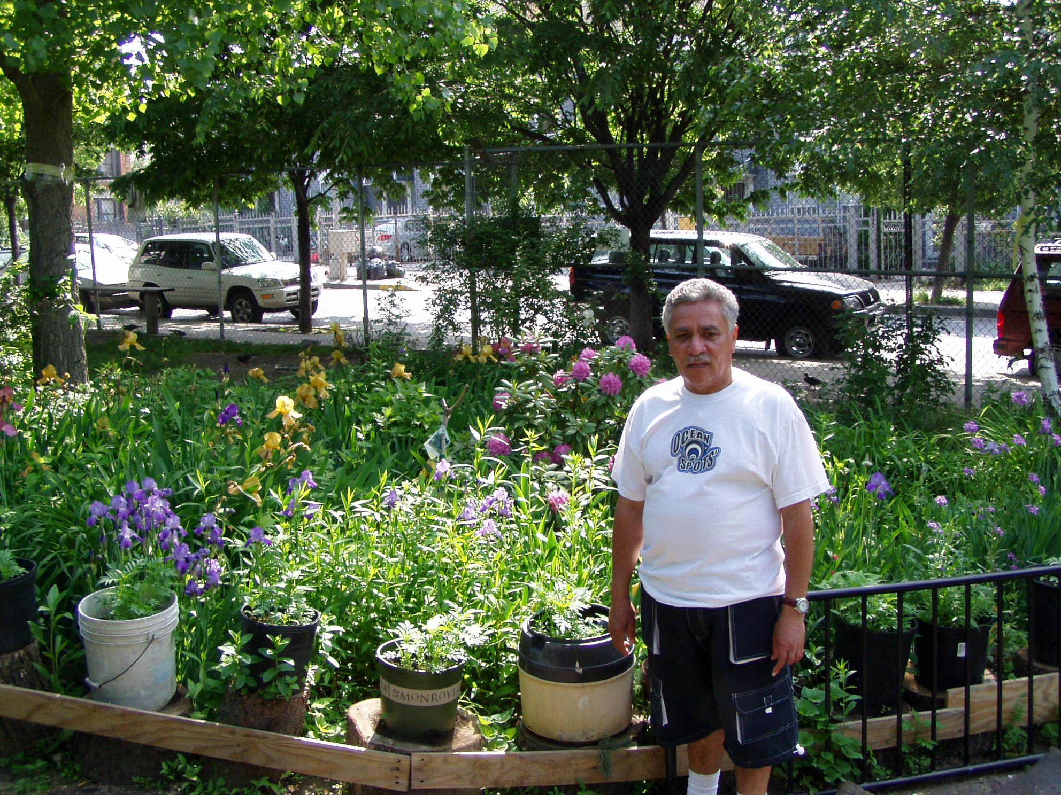
Research & Extension, Objectives & Priorities
Importance
Urban areas are an important CH market:
More people now live in urban areas than rural areas
Integrating the green environment with the built environment is critical to environmental & public health
Funding
NICH
Objectives
Notes:
GAIL:
These statistics suggest the importance of urban areas to growing the market for consumer horticulture plants, associated products, and services. In an increasingly urbanized world, plants, gardens, and greenspace are going to become increasingly important to improving environmental health and public health. Integrating plant materials into the urban, built environment stands to benefit society in so many different dimensions. Documenting the environmental, social, AND economic benefits of consumer horticulture plants, products, and services with rigorous research~ and then sharing best management practices via extension, can help grow the consumer horticulture market beyond households ~ to urban planners, construction firms, government agencies, and more.
Better yet, research in consumer horticulture landscapes can be quickly disseminated to the general public, via the extensive, national network of Extension Master Gardener programs. The 90,000 Extension Master Gardener volunteers can share consumer horticulture messaging and research-based best practices, to promote rapid adoption and scaling of consumer horticulture across cities, suburbs, and towns.

Slide 7
Research & Extension, Objectives & Priorities
Importance
Investing in consumer horticulture research and extension will:
increase sales of specialty crops
promote sustainability of urban environments
benefit public health initiatives
Compared to production agriculture, consumer horticulture research is lagging
Funding
NICH
Objectives
Notes:
There are pressing questions in consumer horticulture, and addressing these with research and extension can increase sales of specialty crops, promote the sustainability of urban environments, and benefit public health initiatives.
And as our country and world becomes ever more urbanized, we expect both the number and the importance of these pressing questions to increase. To provide the answers that will increase sales, sustainability, and public health, there needs to be deliberate investments in consumer horticulture research and extension. However, compared to production agriculture, research in consumer horticulture is lagging at the federal and state levels. With a few notable exceptions, there is a general absence of consumer horticulture from federal funding portfolios.

Slide 8
Research & Extension, Objectives & Priorities
Importance
Calls for grant applications: RFAs
We need objectives that are broad enough to apply to various RFAs, but also fit needs that we know exist.
Funding
NICH
Objectives
Notes:
ELLEN
So how do we accrue more success with state and federal funding? We need to position consumer horticulture to be competitive for targeted calls for grant applications, which are often referred to as RFAs (or requests for applications).
We need objectives that are broad enough to apply to specific RFAs, but that also meet the needs that we know exist.
Where does consumer hort fit into large RFAs, such as those administered by the USDA?

Slide 9
Research & Extension, Objectives & Priorities
Importance
“The purpose of the SCRI program is to address the critical needs of the specialty crop industry by awarding grants to support research and extension that address key challenges of national, regional, and multi-state importance in sustaining all components of food and agriculture, including conventional and organic food production systems.”
Multistate|Trans-Disciplinary|Communicate Results
Funding
NICH
Objectives
Notes:
ELLEN:
Consumer Horticulture projects have had the most success, at the federal level, with the USDA Specialty Crop Research Initiative, which is referred to as the SCRI. The SCRI has funded a multi-state sustainable turf project, and is also the program we applied to, in order to support this national meeting.
SCRI gives priority to projects that are multistate, multi-institutional, or trans-disciplinary, and include explicit mechanisms to communicate results to producers and the public.

Slide 10
Research & Extension, Objectives & Priorities
Importance
Two-Stage Process of SCRI Application Review
Stakeholder Relevance Review ~ why is the project important to Consumer Hort stakeholders?
  Reviewed by industry representatives from many different specialty crop sectors ~ who decide who to invite to submit a full proposal.
Full proposals undergo technical review by scientists and other technical reviewers
Funding
NICH
Objectives
Notes:
ELLEN:
A somewhat unique aspect of the SCRI is the importance of stakeholder input
SCRI reviews are completed in two stages.
First, proposal are reviewed by stakeholders. Industry representatives from across many different specialty crop sectors, review each proposal and ask ‘why is this project important to Consumer Horticulture stakeholders?’ Only proposals that pass this stakeholder relevancy review are invited to submit a full proposal.
Those invited to submit a full proposal must then pass a technical review committee. During this phase, scientists and other technical reviewers consider factors such as the experimental design, qualifications of the research and extension team, and the importance of each proposed project to advancing the science of specialty crop production.

Slide 11
Research & Extension, Objectives & Priorities
Importance
NICH Goals & Objectives:
Were developed over two years, and have been repeatedly vetted
Serve as Consumer Horticulture Research & Extension Objectives & Priorities
Are flexible enough to encompass just about any research or extension project that would be a consumer horticulture priority
Are good for scientists, extension professionals, and a broad base of consumer horticulture industries.
Funding
NICH
Objectives
Notes:
GAIL
Ellen and I are going to present the NICH goals and objectives ~ but before we get there, just a few quick notes.
These goals and objectives were developed by NICH committees over the course of two years, and have been repeatedly vetted by the stakeholders in industry, academia, and in the non-profit sector.
The goals guide NICH’s work, but also serve as broad research and extension objectives and priorities for consumer horticulture.
One of the strongest aspects of these goals and objectives are that they are flexible enough to encompass just about any research or extension project that would be a high priority project in consumer horticulture
Another strength of these goals and objectives is that they serve the needs of a broad base of consumer horticulture industries, while addressing key questions and projects that are of interest to scientist and extension professionals.

Slide 12
Research & Extension, Objectives & Priorities
Importance
Three Broad Goals:
Cultivate Healthy, Connected and Engaged Communities
Restore, Protect, and Conserve Natural Resources through Consumer Horticulture Research and Education
Recognize Consumer Horticulture as a Driver of the Agricultural Economy
Funding
NICH
Objectives
Notes:
ELLEN
NICH has three broad goals:
Cultivate Healthy, Connected and Engaged Communities
Restore, Protect, and Conserve Natural Resources through Consumer Horticulture Research and Education
To ensure that Consumer Horticulture is recognized as a Driver of the Agricultural Economy
Each of these goals has an associated list of objectives. Together, these serve as NICH’s Research and Extension Objectives and Priorities. We’ll present the these objectives and priorities, over the next few slides, and will provide an example of how INVESTING in consumer horticulture research and extension will benefit consumer horticulture industries and stakeholders.

Slide 13
Research & Extension, Objectives & Priorities
Importance
Cultivate Healthy, Connected & Engaged Communities
Educate the public on nutritional, physical, psychological, and social health benefits of Consumer Horticulture.
Provide policymakers with current scientific information that supports the social and community health impacts of Consumer Horticulture.
Strengthen the adoption of Consumer Horticulture in the U.S. as an effective tool for improving human health and community well-being across diverse populations.
Funding
NICH
Objectives
Notes:
ELLEN
Our research and extension objectives and priorities, related to community health are:
To educated the public on the nutritional, physical, psychological, and social health benefits of consumer horticulture,
To provide policymakers with current scientific information that supports the social and community health impacts of consumer horticulture, and
To strengthen the adoption of Consumer Horticulture in the US as an effective tool for improving human health and community well-being across diverse populations

Slide 14
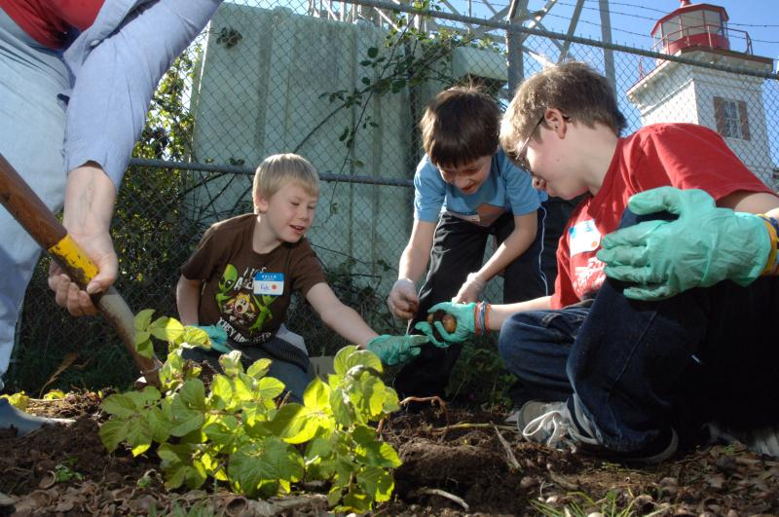


Research & Extension, Objectives & Priorities
Importance
Cultivate Healthy, Connected & Engaged Communities
SNAP-ED limited to direct nutrition education (the food pyramid), and expenditures on food
Due to research and advocacy, policy has changed to allow SNAP-Ed to teach gardening and SNAP-Ed recipients to use benefits to buy plant starts and seeds.
Funding
NICH
Objectives
Notes:
ELLEN
And as an example of how investing in consumer horticulture COMMUNITY research and extension can benefit consumer horticulture industries, we need to look no further than the SNAP-Ed program (formerly known as the food stamp program). This program, which is one of the largest budgetary items for the USDA, used limit education direct nutrition education ~ and focused heavily on the food pyramid. It also limited program expenditures to food.
However, due to research, which showed that garden-based nutrition education programs did a better job of improving healthy eating outcomes, compared to education programs that focused on nutrition principles ~ the program has now expanded to encourage gardening. In fact, the research showed that kids who learned about the food pyramid knew why they should eat more vegetables, but that they did not improve their eating habits. Kids who gardened improved their eating habits, but fared worse on nutrition quizzes. So ~ kids who garden eat healthier, even if they don’t know why they are eating healthier.
Today, SNAP-Ed funds can be used to teach gardening, as a component of a comprehensive nutrition education program. And, families that receive SNAP-Ed benefits can now use these funds to buy edible plant starts and seeds at farmers markets across the nation.

Slide 15

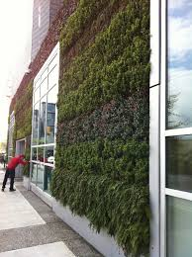
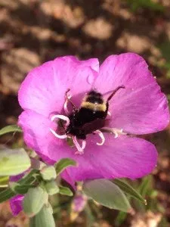
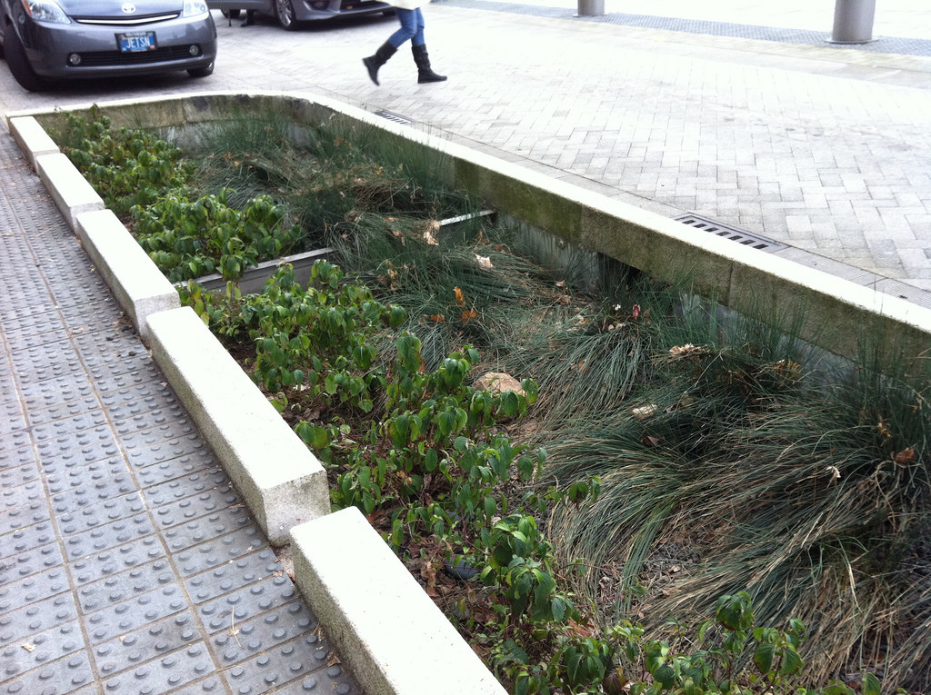
Research & Extension, Objectives & Priorities
Importance
Restore, Protect, and Conserve Natural Resources
Communicate the environmental benefits of Consumer Horticulture.
Develop and promote sustainable practices specific to Consumer Horticulture.
Educate practitioners on the appropriate use of production and management inputs.
Funding
NICH
Objectives
Notes:
GAIL
We have six research and extension objectives and priorities, related to environmental health. They are to:
Communicate the environmental benefits of Consumer Horticulture.
Develop and promote sustainable practices specific to Consumer Horticulture.
Educate practitioners on the appropriate use of production and management inputs.

Slide 16
Research & Extension, Objectives & Priorities
Importance
Restore, Protect, and Conserve Natural Resources (continued)
Identify and implement the positive environmental impacts of Consumer Horticulture on water quantity and quality resources.
Identify and develop plants, products, and technology appropriate to the diversity of landscape and gardening practices to enhance ecosystem services.
Forge a collective strategy with sectors of Consumer Horticulture to proactively address important issues such as the importation, introduction, and spread of invasive species.
Funding
NICH
Objectives
Notes:
Identify and implement the positive environmental impacts of Consumer Horticulture on water quantity and quality resources.
Identify and develop plants, products, and technology appropriate to the diversity of landscape and gardening practices to enhance ecosystem services.
Forge a collective strategy with sectors of Consumer Horticulture to proactively address important issues such as the importation, introduction, and spread of invasive species.

Slide 17
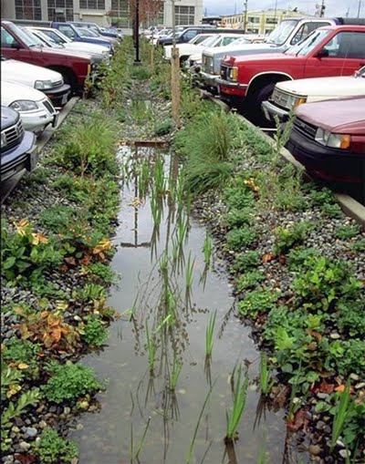
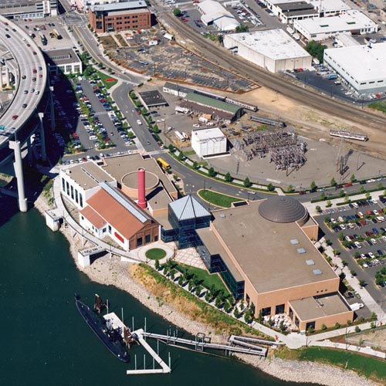
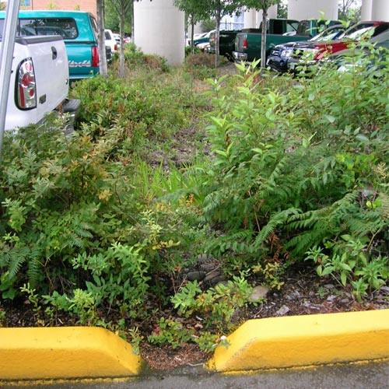
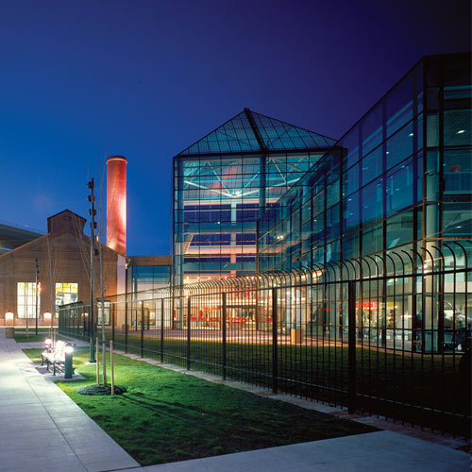
Research & Extension, Objectives & Priorities
Importance
Restore, Protect, Conserve Natural Resources
Portland BES approached Oregon Museum of Science and Tech (OMSI) with a proposed parking lot redesign
OMSI interested, but on a tight budget. Ultimately, 10 swales installed: 6 ft wide, 100-250 ft long.
Swales captured 50% of total suspended solids; improved to 90% with minor adjustments
$78,000 saved in construction costs
Funding
NICH
Objectives
Notes:
GAIL
And as an example of how investing in consumer horticulture ENVIRONMENTAL research and extension can benefit consumer horticulture industries, we can look at any one of many bioswale research and demonstration projects. For those who don’t know, a bioswale is a landscape element that has gently sloped sides (less than 6%) and is filled with vegetation. It helps slow surface water runoff, and can prevent urban drainage systems from overfilling and overflowing during storm events.
One of Oregon’s first bioswale demonstration projects was built at the Oregon Museum of Science and Industry, otherwise known as OMSI. In the late 1980s, Portland’s Bureau of Environmental Services approached OMSI with a proposition for a parking lot redesign. Given OMSI’s science-based mission, they were interested. But, given their non-profit status and tight-budget, they were also apprehensive.
Ultimately, BES and OMSI decided on 10 bioswales, each 6-feet wide and between 100-250 feet long.
Audits of the swales found that they captured 50% of total suspended solids, or eroded run-off, from reaching the adjacent Willamette River. With minor adjustments, the swales improved capture to 90% of total suspended solids, compared to hardscape.
Even better, OMSI reported that they saved $78,000 on this parking lot project. With the bioswales, they did not have to build catchment areas, buried, pipe, or manholes. The swales thus represented an environmental and an economic win ~ replacing hardscape with greenspace, to protect the Willamette River, as well as OMSI’s bottom line.
The success of this project has inspired more and more private real estate projects and governmental agencies to substitute horticulture for hardscape.

Slide 18
Research & Extension, Objectives & Priorities
Importance
Recognize Consumer Horticulture as a Driver of the Agricultural Economy
Document, comprehensively measure, and disseminate the economic impact and benefits of consumer horticulture.
Create a united and recognized voice by building partnerships among all sectors that contribute to Consumer Horticulture.
Train our existing and future workforce to be more professional, knowledgeable, skilled, and safe.
Funding
NICH
Objectives
Notes:
ELLEN
We have five research and extension objectives and priorities, related to environmental health. They are to:
Document, comprehensively measure, and disseminate the economic impact and benefits of consumer horticulture.
Create a united and recognized voice by building partnerships among all sectors that contribute to Consumer Horticulture.
Train our existing and future workforce to be more professional, knowledgeable, skilled, and safe.

Slide 19
Research & Extension, Objectives & Priorities
Importance
Recognize Consumer Horticulture as a Driver of the Agricultural Economy (continued)
Help retail operations and consumer service providers succeed and increase their profitability through the development of better economic management tools and technologies.
Stimulate entrepreneurial opportunities in Consumer Horticulture.
Funding
NICH
Objectives
Notes:
Help retail operations and consumer service providers succeed and increase their profitability through the development of better economic management tools and technologies.
Stimulate entrepreneurial opportunities in Consumer Horticulture.

Slide 20
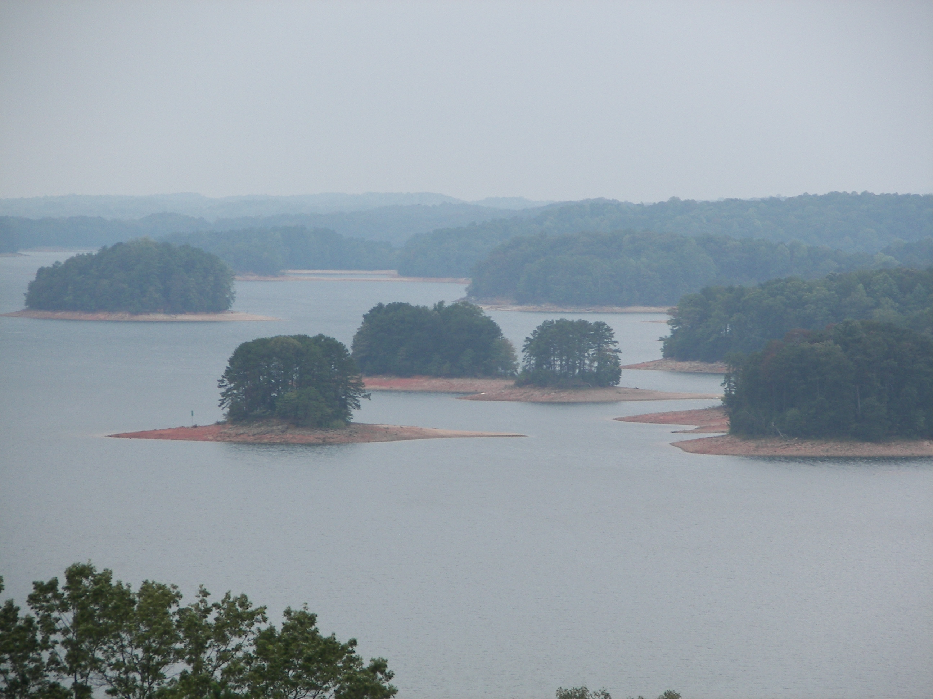
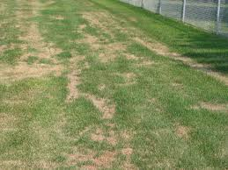
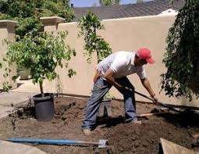
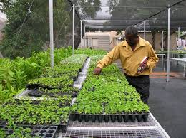


Research & Extension, Objectives & Priorities
Importance
Recognize Consumer Horticulture as a Driver of the Agricultural Economy (continued)
Georgia Drought of 2007-2008; outdoor watering bans were rampant
Decisions made without recognition of the impact that bans would have on Consumer Horticulture industries
Research estimated losses of $262,612,000 for each month of the ban, and industry-wide loss of 35,000 jobs
Legislative action passed a bill protecting industry, and included exemptions for new landscape installations
Funding
NICH
Objectives
Notes:
ELLEN ~ PLEASE WRITE SCRIPT FOR THIS SLIDE
And as an example of how investing in consumer horticulture ECONOMIC research and extension can benefit consumer horticulture industries,
The Georgia Drought of 2007-2008
Outdoor watering bans were rampant
What the heck? It is just grass….
Little recognition of economic impact Consumer Horticulture industries
Quick research work estimated
A loss of $262,612,000 for each month of the ban
Industry-wide job losses of 35,000
Legislative action
Passage of a bill protecting industry
Watering exemption for new installations

Slide 21
Research & Extension, Objectives & Priorities
The importance of research & extension priorities
State, federal funding to support CH research & extension
NICH Goals & Objectives, Overview
Research & Extension Objectives & Priorities
Notes:
GAIL
We hope that we’ve provided a compelling argument for the need to position consumer horticulture to compete for high dollar research and extension funding at the federal and state levels.
We also hope that we’ve provided a glimpse into the path we intend to take, by responding to funding RFAs with proposals that address high priority research and extension objectives. The list we’ve presented alludes to projects that we could pursue across disciplines, including plant breeding, landscape design, green technologies, social science, real estate research, and workforce development. There are so many opportunities for consumer horticulture to take the lead in healthy, sustainable, and profitable urban design ~ and to work towards a vision where gardening and landscapes are viewed as indispensible aspects of urban living.

Slide 22
Committee Reports
Pam Bennett, Deborah Hamrick, Julie Weisenhorn
NICH Committee Chairs
Notes:
GAIL:
And with that, we pass the baton to our Pam Bennett, Debbie Hamrick, and Julie Weisenhorn, who will present NICH committee reports from the community and social health, economic, and environmental committees. Keep an eye out for where the research and extension work undertaken by each committee compliments the research an extension priorities and objectives that we shared with you.

